Slide 1
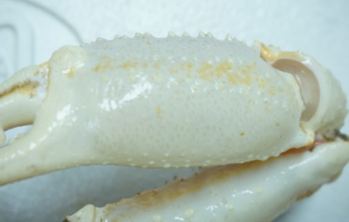

Carapace condition validation & correction:
Colorimeter measurements on underside of chela (males >= 90 mm):
Two peaks are observed : new and old-shelled crab.
Notes:
Precise measurements of carapace colour were made using a colorimeter. These were made on the underside of about 1000-1200 male chelae (CW > 90 mm) during the 2017 and 2018 surveys, for a variety of carapace conditions.
One of the measured values is strongly associated with the yellowing of the carapace as it ages.
Here we see two frequency histograms of these yellowness values on for samples measured during the month of August for the 2017 (top panel) and 2018 (bottom panel).
We see that the sample distributions between these two years are very similar, each with two peaks, or modes: a narrow one on the left-hand side which corresponds to new-shelled crab and another, and another, more diffuse peak, corresponding to a wider range of yellowness values for old-shelled crab.
Our interpretation of these peaks as new and old-shelled crab is supported by the fact that the narrow peak for new-shelled crab gradually shifts towards to the yellower end of the spectrum as the survey progresses.
Traditionally, carapace condition observations are used to identify new and old-shelled crab, with CC1 & 2 as new-shelled and CC3, 4 & 5 as old-shelled.
If we superimpose these classifications over the colorimeter observations, we get the following graph:

Slide 2
Carapace condition validation & correction:
Notes:
So this is the same plot as before, only now in black we have the colorimeter observations which were identified as new-shelled using carapace condition, and in grey we have colorimeter observations which were identified as old-shelled (carapace condition 3, 4 & 5).
So in 2017 (the top panel), there are only a few carapace condition observations (CC2 specifically) which are within the yellower domain of old-shelled crab. We feel that these were CC2 misclassifications because these were not present in the July and September samples.
The problem in 2018 was that a large proportion of CC2 were squarely in the yellower end of the scale.
Since the new-shelled and old-shelled classifications are used to distinguish between fishery recruitment and residual biomass, this resulted in inflated levels of recruitment and a depleted residual biomass.
So how can we remedy this?

Slide 3
Carapace condition validation & correction:
Notes:
We can perform what is called a clustering analysis, which fits curves around the new and old-shelled groups, and can yield as a by-product, the proportion of each group in a sample, which is proportional to the area under each of the two distribution curves (red lines).
Keep in mind, that this clustering is done independently of the observed carapace conditions. They are purely based on colorimeter observations.
We can then compare the colorimeter-based proportions of new and old shells against those given by the observed carapace conditions.
These analyses were performed for each shell condition (e.g. what proportion of shell condition 1s were identified as new-shelled by the colorimeter, SC2 … )
We added some more complexity to the underlying colorimeter model, allowing for temporal yellowing of new-shelled crab towards as the survey season progressed.
Comparing the colorimeter and CC new/old proportions yielded a table of classification probabilities (Table X) in the research document.

Slide 4
Carapace condition validation & correction:
Table 1. Probability of identifying large male (> 90 mm) crab as new-shelled by survey week and observed carapace condition. New-shelled identification is based on colorimeter data during the 2017 and 2018 trawl surveys. 95% credibility intervals are shown in parentheses. Shaded in grey are values which suggest that carapace condition observations are at odds with the colorimeter data.
 |  | 2017 |  |  |  | 2018
Survey week |  | CC1 | CC2 | CC3 | CC4&5 | CC1 | CC2 | CC3 | CC4&5
1 |  | 0.9996 (0.9967, 1) | 0.9818 (0.8812, 1) | 0.0005 (0, 0.0033) | 0.0003 (0, 0.002) | 0.9644 (0.8433, 0.9984) | 0.3344 (0.0003, 0.8574) | 0.0082 (0, 0.0729) | 0.0004 (0, 0.0017)
2 |  | 0.9996 (0.9966, 1) | 0.9856 (0.9049, 1) | 0.0004 (0, 0.003) | 0.0003 (0, 0.0017) | 0.9833 (0.9048, 1) | 0.2109 (0, 0.99) | 0.0021 (0, 0.0127) | 0.0003 (0, 0.0017)
3 |  | 0.9997 (0.9965, 1) | 0.9803 (0.8744, 1) | 0.0005 (0, 0.0031) | 0.0002 (0, 0.0015) | 0.9825 (0.9391, 0.9999) | 0.0189 (0, 0.0985) | 0.0008 (0, 0.0079) | 0.0002 (0, 0.0014)
4 |  | 0.9989 (0.9899, 1) | 0.9898 (0.936, 1) | 0.0027 (0, 0.0141) | 0.0004 (0, 0.002) | 0.9908 (0.9604, 1) | 0.028 (0, 0.1614) | 0.0007 (0, 0.0068) | 0.0002 (0, 0.0016)
5 |  | 0.9991 (0.9947, 1) | 0.8412 (0.6811, 0.9603) | 0.0003 (0, 0.0024) | 0.0003 (0, 0.0017) | 0.9924 (0.9695, 1) | 0.0168 (0, 0.0924) | 0.0007 (0, 0.0073) | 0.0002 (0, 0.0016)
6 |  | 0.9992 (0.995, 1) | 0.4784 (0, 0.9869) | 0.0008 (0, 0.0031) | 0.0022 (0, 0.0021) | 0.9922 (0.9674, 1) | 0.0974 (0, 0.2931) | 0.0006 (0, 0.0069) | 0.0002 (0, 0.0013)
7 |  | 0.9959 (0.994, 1) | 0.917 (0.821, 0.9836) | 0.0003 (0, 0.0023) | 0.0002 (0, 0.0014) | 0.9816 (0.9367, 0.9987) | 0.4033 (0.2165, 0.5994) | 0.0009 (0, 0.0089) | 0.0002 (0, 0.0015)
8 |  | 0.9958 (0.9936, 1) | 0.984 (0.8919, 1) | 0.0004 (0, 0.0029) | 0.0003 (0, 0.0016) | 0.9896 (0.9537, 1) | 0.0329 (0, 0.1939) | 0.0014 (0, 0.0113) | 0.0002 (0, 0.0016)
9 |  | 0.9963 (0.9936, 1) | 0.9904 (0.94, 1) | 0.0008 (0, 0.0036) | 0.0003 (0, 0.0018) | 0.9912 (0.9628, 1) | 0.6054 (0.4515, 0.75) | 0.0049 (0, 0.0818) | 0.0002 (0, 0.0016)
10 |  | 0.9956 (0.9942, 1) | 0.9918 (0.9515, 1) | 0.0004 (0, 0.0026) | 0.0002 (0, 0.0015) | - | - | - | -
11 |  | 0.9965 (0.9932, 1) | 0.9884 (0.9361, 1) | 0.0003 (0, 0.0031) | 0.0002 (0, 0.0017) | - | - | - | -
Notes:
So this table shows to the probability of a sample being identified as new-shelled for each shell condition.
So we expect that CC1 be classified as new-shelled by the colorimeter, and indeed they are and the probabilities are very near 1 for all weeks of the 2017 and 2018 surveys.
Similarly, CC3 and CC4&5 show probabilities very near 0, i.e. there is a very low probability that these would be identified as new-shelled, as expected, since they are old-shelled.
The problem lies in the identification of CC2.
During the 2017 survey, there were only one serious deviation from 1 during the sixth week of 2017, while all other weeks had high probabilities, as expected.
However, during the 2018 survey, large proportions of CC2 were classified as old-shelled by the colorimeter, and these were variable from week to week.
As a corrective, we assumed that the colorimeter identifications proportions were correct, and used these classification probabilities to reassign portions of shell condition 2 crab from the new-shelled category into the old-shelled category.
In particular, the application of this correction resulted in about 5000 tonnes being reassigned to the residual biomass from the fishery recruitment category.

Slide 5
Mature Female Mortality:

Slide 6
Mature Male Mortality:

Slide 7
Trawl opening by survey year:

Slide 8
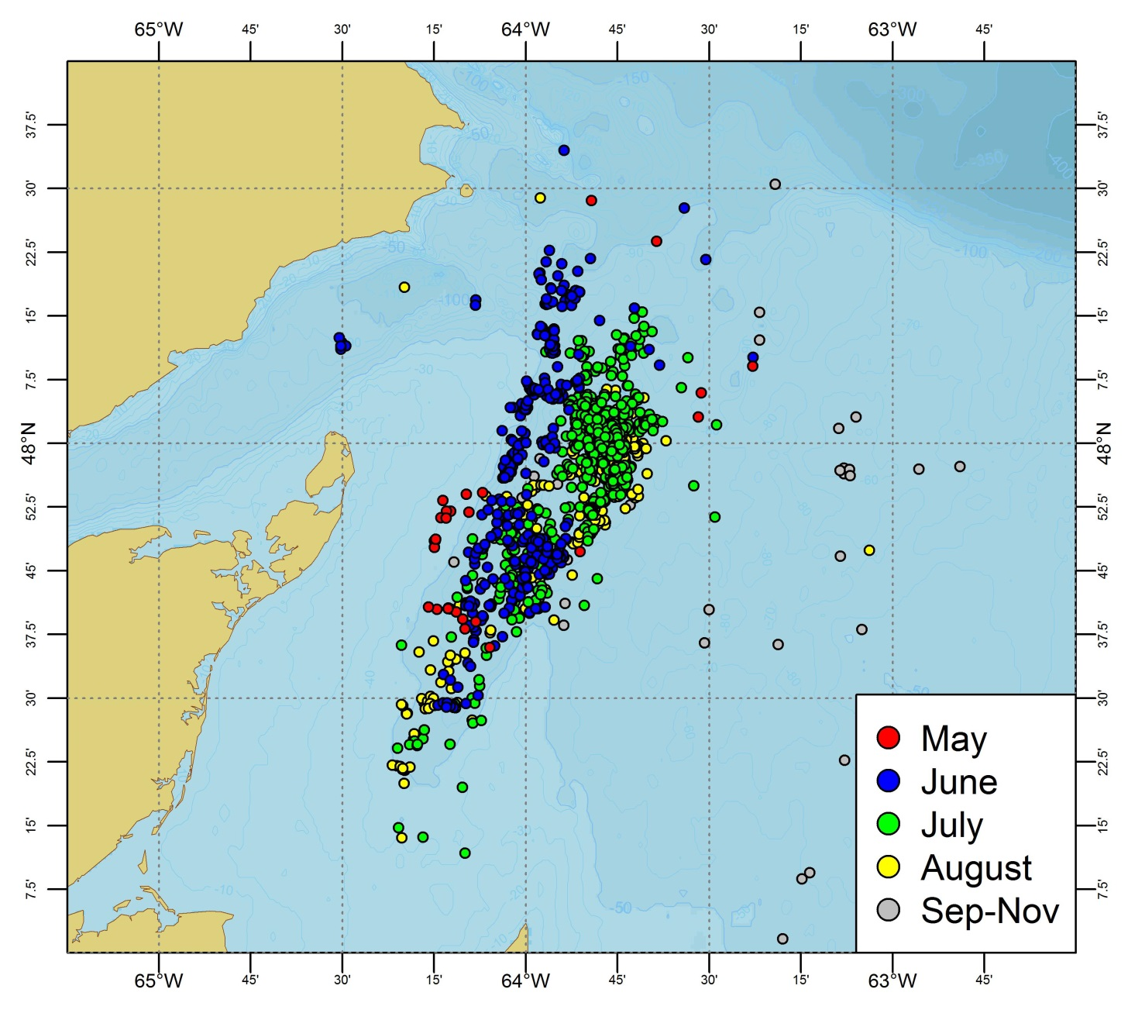
Right Whale Sightings 2018:

Slide 9
Right Whale Sightings Depth Distribution in 2018:
n = 1827 sightings
0.65 % observations (8) below 40 meters.
3.2 % observations (60) below 50 meters.

Slide 10
Eggs Remaining Proportions:

Slide 11
Egg Colour:

Slide 12
Gonad Colour:

